Slide 1
TANZANIA WATER WELL STATUS AND DISTRIBUTION: A PREDICTIVE ANALYSIS

Slide 2
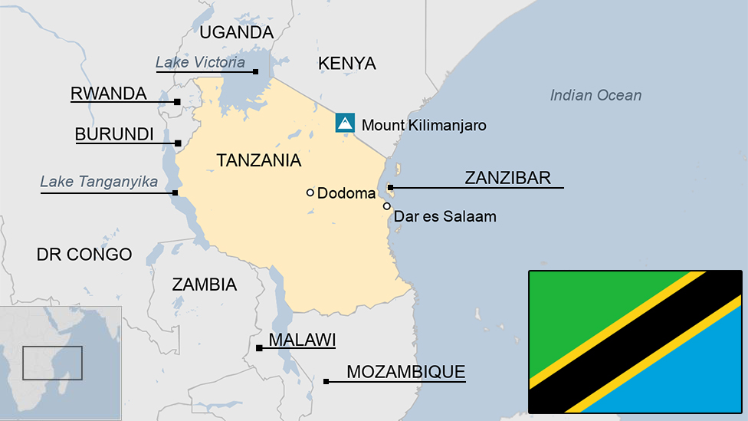
Overview
Project Overview
Location: Tanzania, East Africa
Population: 62 million
Geography: Diverse, including Serengeti, Ngorongoro Crater, Zanzibar
Water Access
Rural Dependence: Groundwater sources (wells, boreholes, springs)
Challenges: Uneven distribution, seasonal variations
Research Focus
Objective: Predict water well functionality using machine learning

Slide 3
Business and Data Understanding
Business Understanding
Objective: Ensure reliable water supply in Tanzania
Goal: Predict water well functionality to prioritize maintenance
Impact: Improve water access for rural communities, optimize resource allocation
Data Understanding
Source: Driven Data competition "Pump it Up: Data Mining the Water Table"
Key Datasets:
X_train.csv: Features for training (e.g., pump type, installation date)
y_train.csv: Well statuses (functional, non-functional, needs repair)
Test set: Features for prediction
Data Highlights
Some example of Features:
Type of pump
Installation date
Installer
Region
Labels: Well status (functional, non-functional, needs repair)

Slide 4
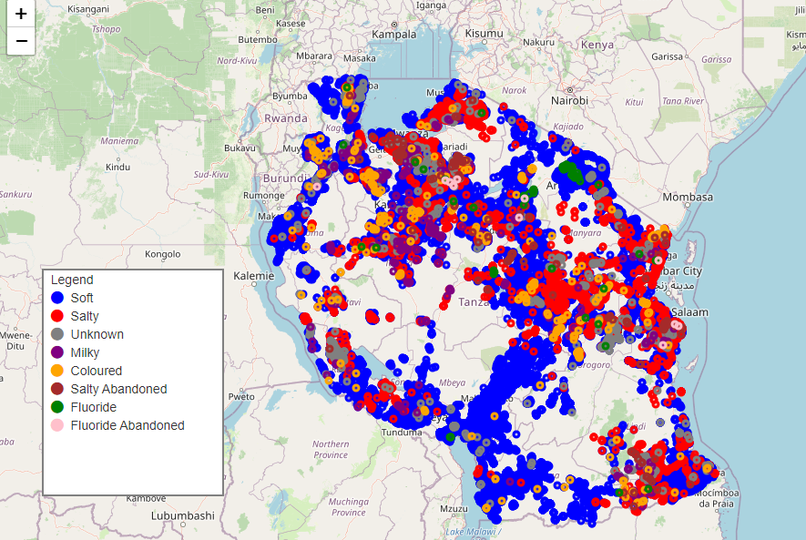
Water Quality Distribution in Tanzania

Slide 5
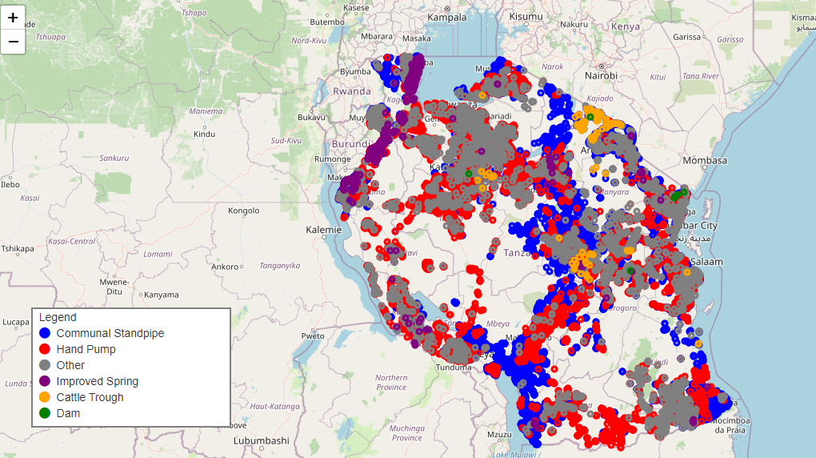
Water Point Distribution in Tanzania

Slide 6
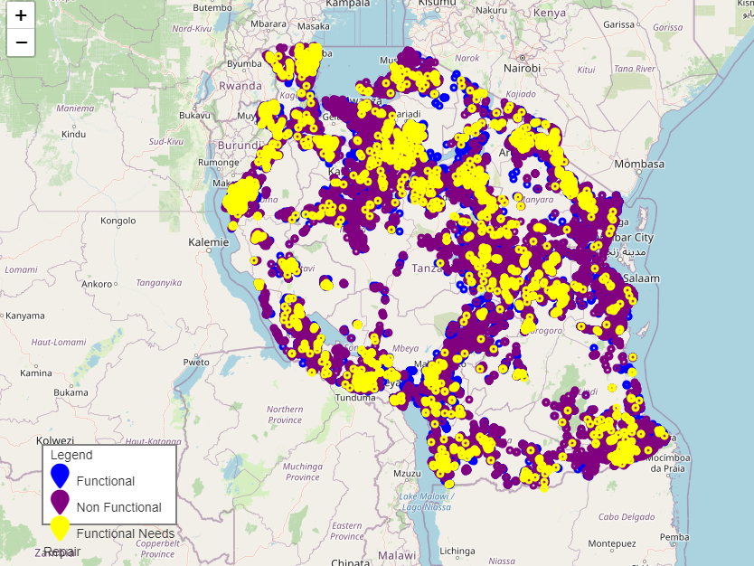
Water Source Status

Slide 7
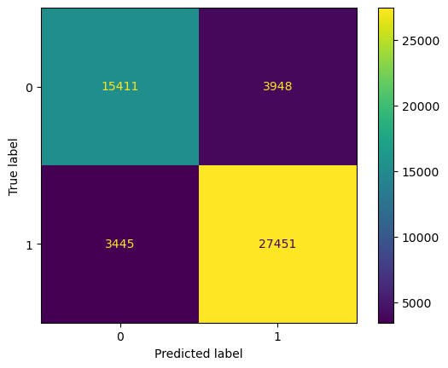
Best Model- Random Forest
Mean cross-validation score: 0.85
F1 Score (Cross-Validation): 0.85
Recall (Cross-Validation): 0.852
Precision (Cross-Validation): 0.8523

Slide 8
Recommendations
Use Random Forest Model: Predict well pump conditions
Accuracy: At least 85% success rate
Issue: High density of pumps needing repairs
Central and Southern Regions: Focus on Dodoma and Mtwara
Issue: High density of non-functional pumps
Northern Regions: Focus on Bukoba and Arusha

Slide 9
Next Steps
Monitor Performance
Ensure model maintains at least 85% accuracy
Improve Data Collection:
Enhance data accuracy for better predictions
Ongoing Evaluation
Track Progress: Regularly assess the impact of interventions and adjust based on new data and findings

Slide 10
Thank You

